Slide 1
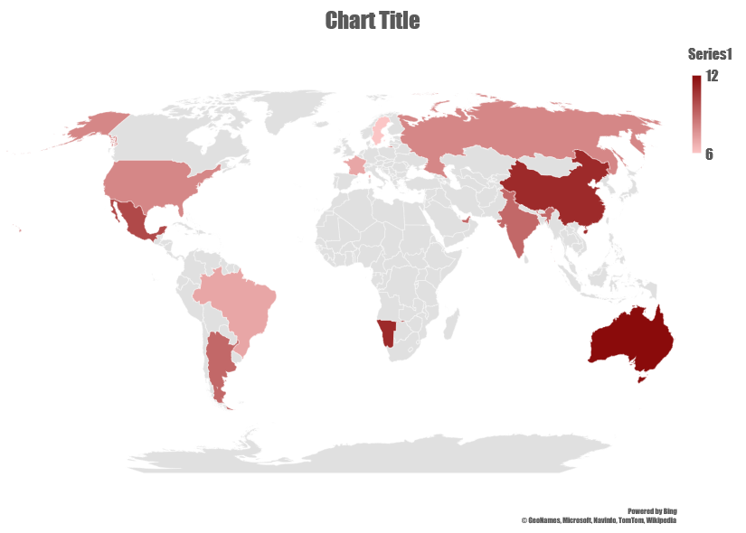
WEB SCRAPING PROJECT WITH PYTHON
AKSHAY S. PADGELWAR

Slide 2
Problem statement :- analysis on mobile data

Slide 3
DOMAIN EXPLANATION Mobile application domain (as a part of real world) includes the business needs, constraints and related technical issues imposed by mobile applications. RESPECTIVELY, the mobile technology domain (as an area of knowledge) represents the class of technical solutions addressing the problems common in the mobile application domain. Domain names are used to identify one or more IP addresses. For example, the domain name FLIPKART.com represents about a dozen IP addresses. Domain names are used in URLs to identify particular Web pages url:- https://www.flipkart.com/search?q=mobile&otracker=search&otracker1=search&marketplace=FLIPKART&as-show=on&as=off

Slide 4
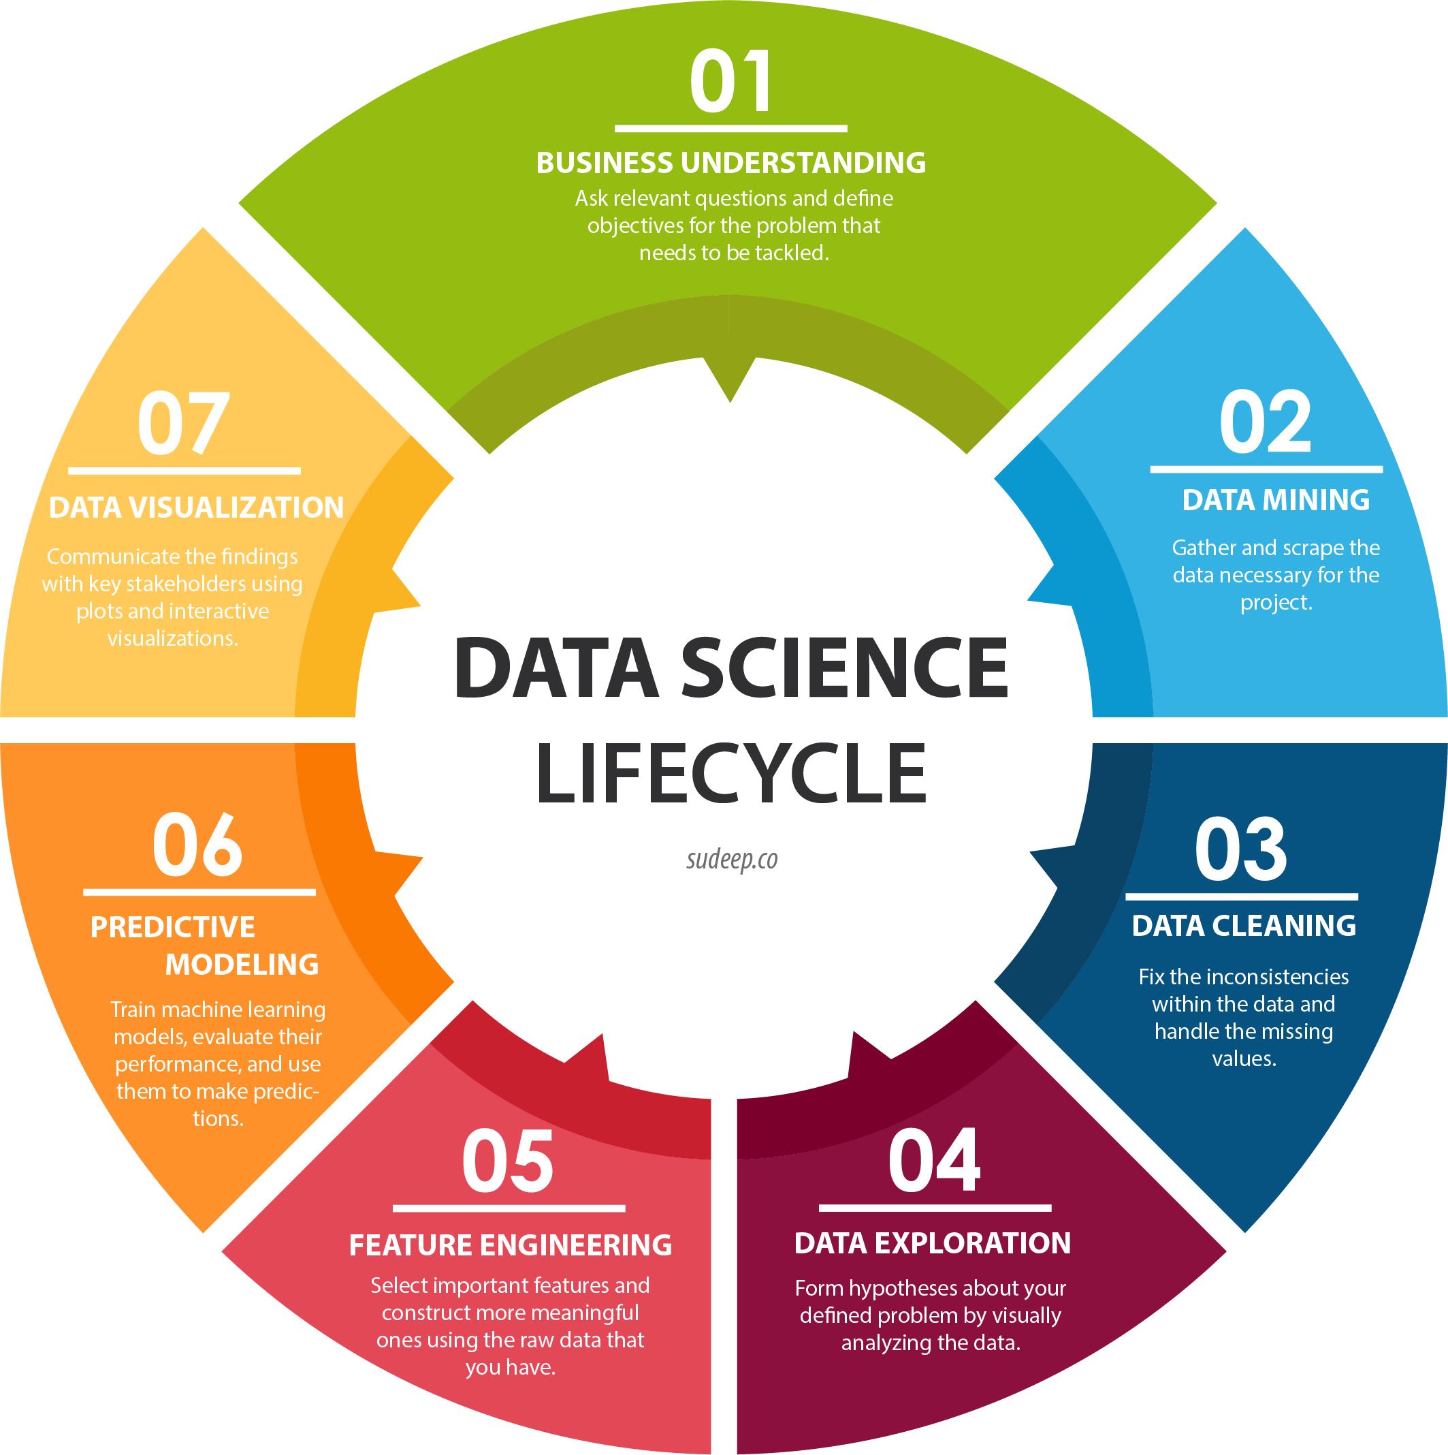
Data science life cycle

Slide 5
WHAT IS PYTHON ? Python is an interpreted, object-oriented, high-level programming language with dynamic semantics. Python's simple, easy to learn syntax emphasizes readability and therefore reduces the cost of program maintenance. Python supports modules and packages, which encourages program modularity and code reuse.

Slide 6
WHAT IS WEB SCRAPING ? Web scraping is a term for various methods used to collect information from across the Internet. Generally, this is done with software that simulates human Web surfing to collect specified bits of information from different websites. Those who use web scraping programs may be looking to collect certain data to sell to other users, or to to use for promotional purposes on a website. Web scraping is also called Web data extraction, screen scraping or Web harvesting.

Slide 7
LIBRARIES USED IN PROJECT
Warnings
Pandas
Numpy
Matplotlib.pyplot
Seaborn
Requests
BeautifulSoup
Re
Time

Slide 8
FLIPKART WEBSITE . url:- https://www.flipkart.com/search?q=mobile&otracker=search&otracker1=search&marketplace=FLIPKART&as-show=on&as=off

Slide 9
ExtraCTING BELOW FEatures 1.Specification. 2.RAM. 3.Screensize. 4.Brand.

Slide 10
CLEANING THE DATA
mobile_df.Brand[0] type(mobile_df.Brand[0]) convert the list item into string ''.join(mobile_df.Brand[0]) type(''.join(mobile_df.Brand[0])) mobile_df.specification = mobile_df.specification.apply(lambda x:''.join(x)) mobile_df.RAM = mobile_df.RAM.apply(lambda x:''.join(x)) mobile_df.Brand = mobile_df.Brand.apply(lambda x:''.join(x)) mobile_df['ScreenSize_cm'] = mobile_df.ScreenSize.apply(lambda x:x[0]) mobile_df['ScreenSize_inch'] = mobile_df.ScreenSize.apply(lambda x:x[1]) float(mobile_df.Price[0].replace('₹','').replace(',',‘’)) mobile_df['Price'] = mobile_df['Price'].apply(lambda x:x.replace('₹','').replace(',','')).astype(float)

Slide 11
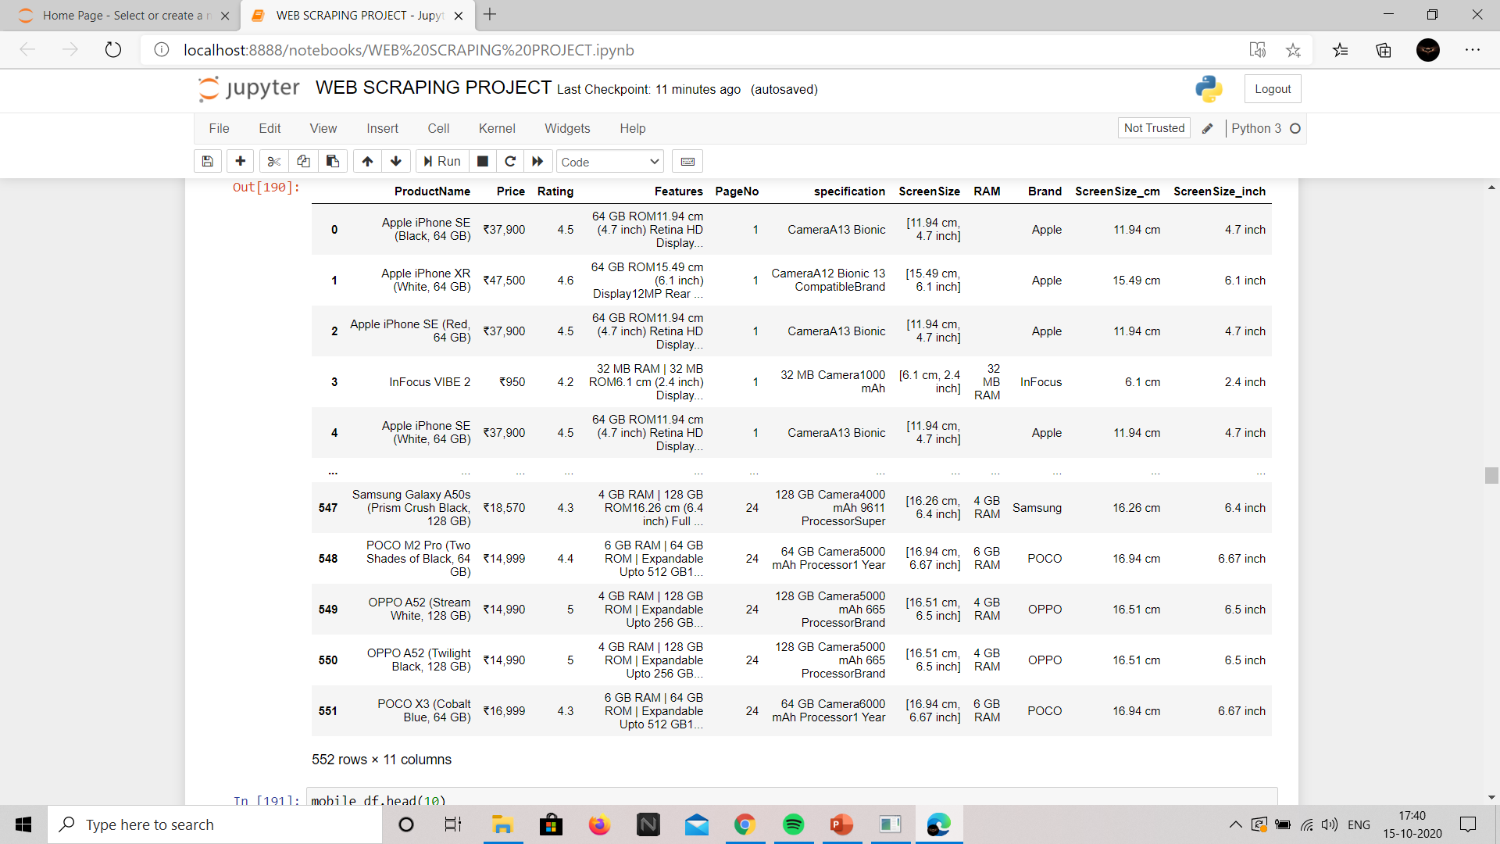
FINAL DATAFRAME

Slide 12
Data Visualizations
Univariate analysis:- provides summary statistics for each field in the raw data set (or) summary only on one variable.
Bivariate analysis:- is performed to find the relationship between each variable in the dataset and the target variable of interest (or) using 2 variables and finding relationship between them, Ex:-Box plot , Violin plot.
Multivariate analysis:- is performed to understand interactions between different fields in the dataset (or) finding interactions between variables more than 2. Ex:- scatter plot.

Slide 13
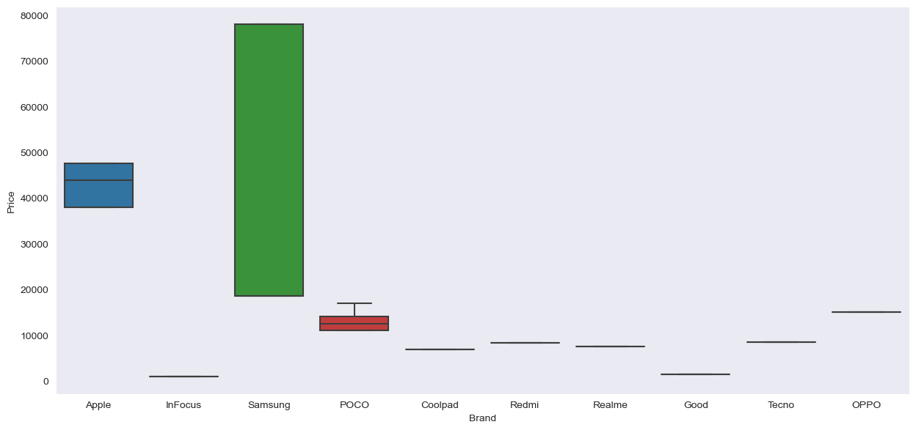
Boxplot

Slide 14
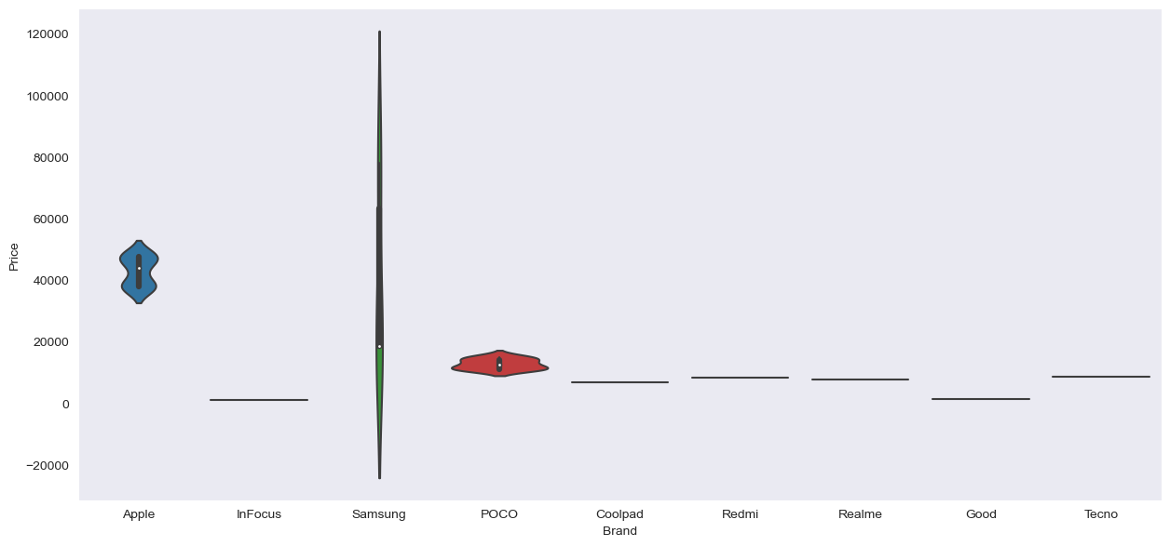
Violin plot

Slide 15
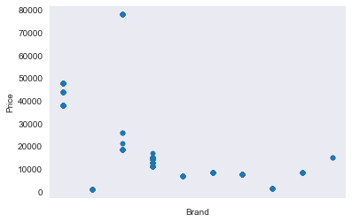
Scatter plot

Slide 16
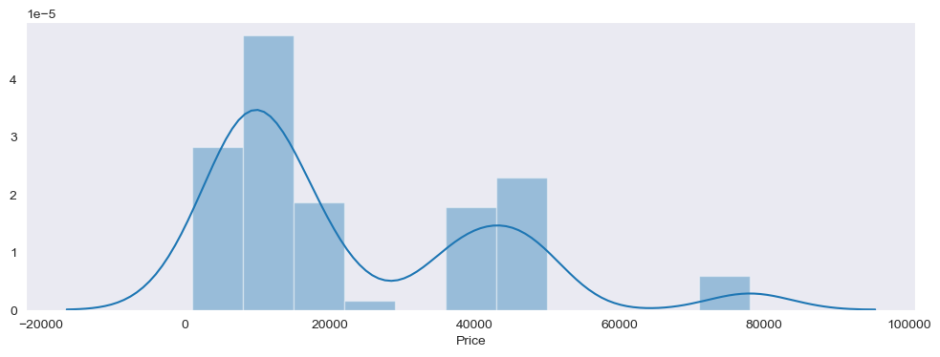
Checking the Distribution of the Price Columns

Slide 17
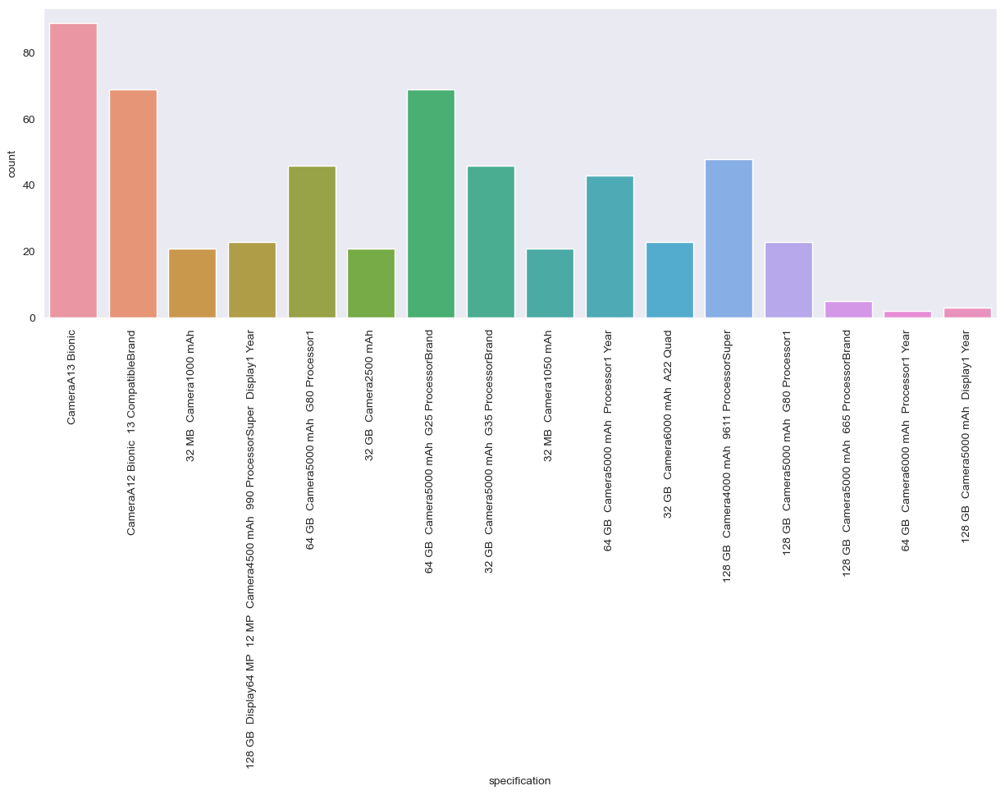
SHOW THE Distribution of the count and specification

Slide 18
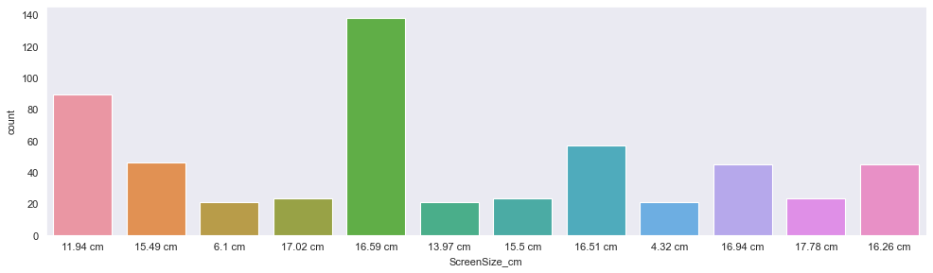
VISUALIZE Distribution of the count and screen size

Slide 19
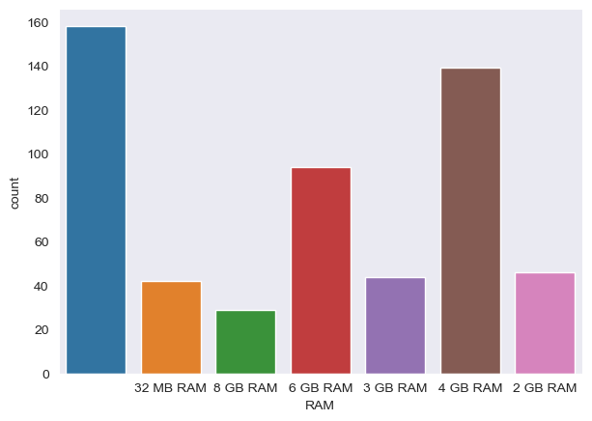
SHOW THE Distribution of the count and RAM

Slide 20
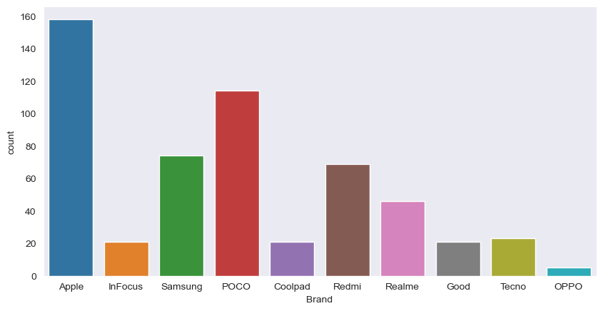
VISUALIZE Distribution of the count and brand

Slide 21
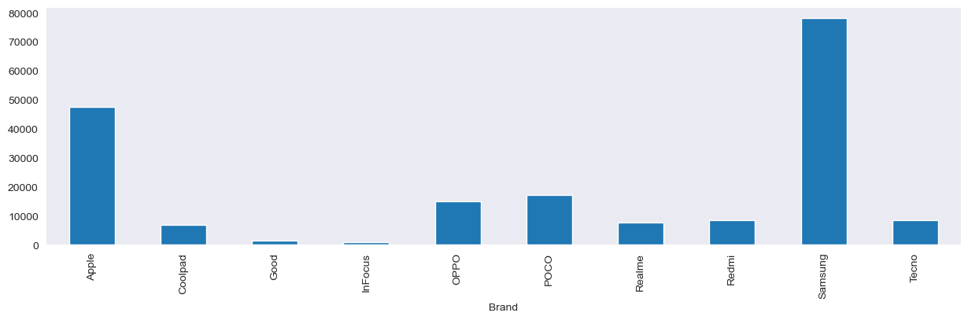
WHAT IS THE maximum Price from each Brand ?

Slide 22
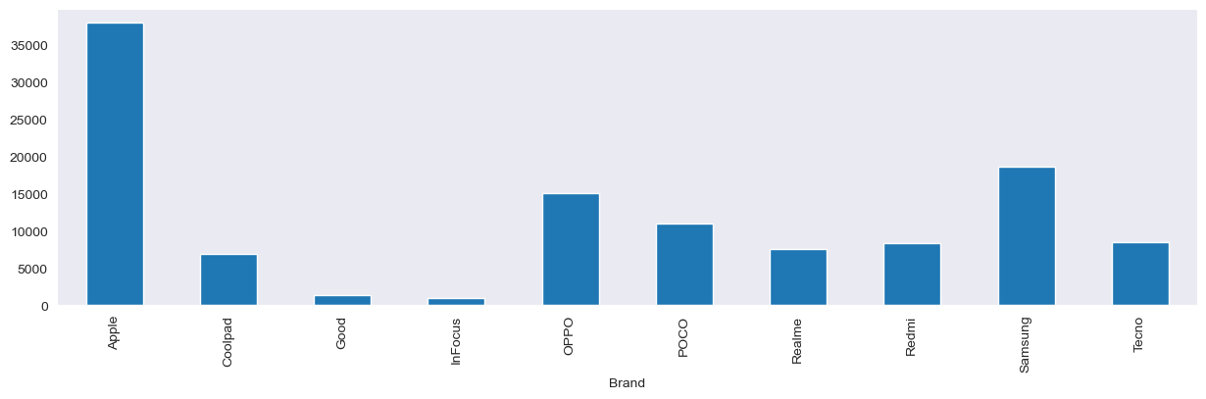
WHAT IS the minimum Price from each Brand ?

Slide 23
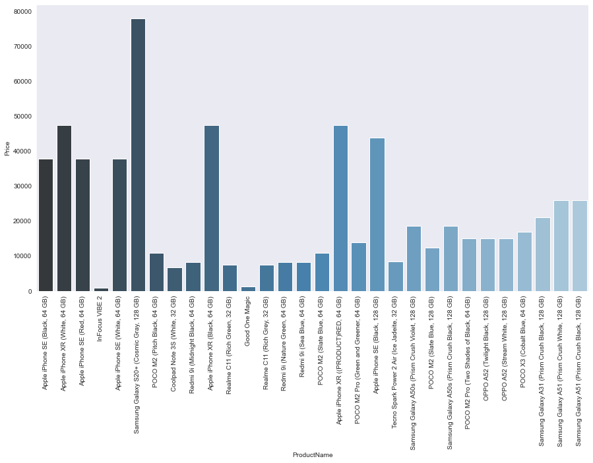
VISUalize each product name and price

Slide 24
CONCLUSION By analyzing the MOBILE DATA OF EACH BRAND using Data Investigation and Analysis we gathered most EXACT INFORMATION IN DETAIL using the VISUALIZATIONS. We can conclude that Data Investigation and Analysis gains insights into cUSTOMER sentiment and can help companies in ADDRESSING THE PROBLEMS. This technique provides an opportunity to improve the overall customer experience which returns huge profits.

